Slide 1
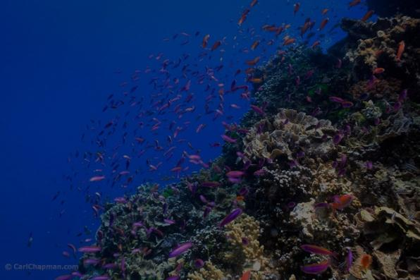
Provision of Refuge Volume by Corals and Simulation-Based
Habitat Equivalency Analysis
John W. McManus ¹ and Lisa C. McManus ²
¹ National Center for Coral Reef Research
University of Miami
² Department of Ecology and Evolutionary Biology Princeton University

Slide 2
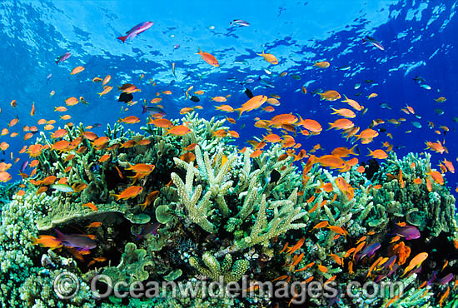
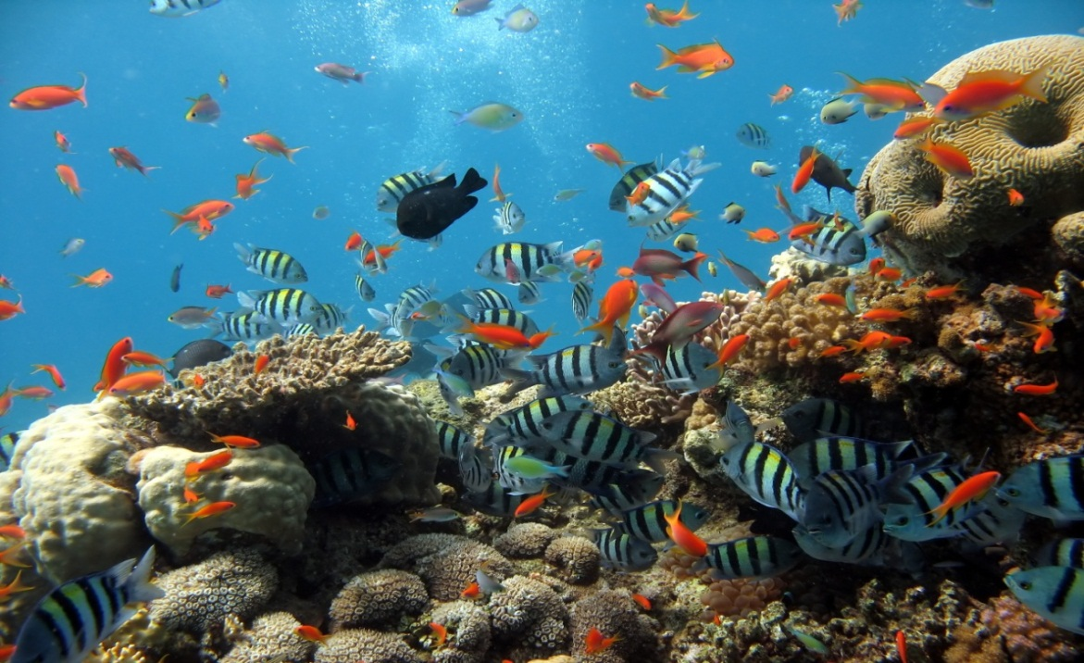
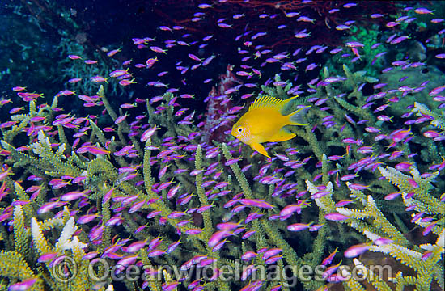
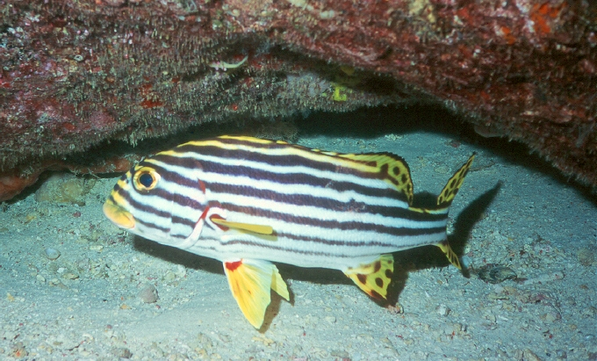
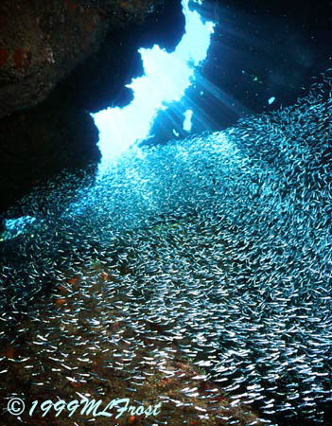
Refuge Volume
xda-wallpapers.com
Steve Turek/Coral Reef Alliance
Coral Reef Alliance
Notes:
These fish are mostly here because they have places to hide when disturbed. Other fish appear there because the prey they are after expect to be able to hide there. This is an important feature of coral reefs that keep them abundant in organisms and species.

Slide 3
Requirements for Refuge Volume Estimations
Estimation procedure should scale properly.
At a minimum, one should find a factor which is multiplied by a dimension cubed.
vol = c_{f}d³
Estimate
surf = c_{f}d²
Dimension (e.g. radius)

Slide 4
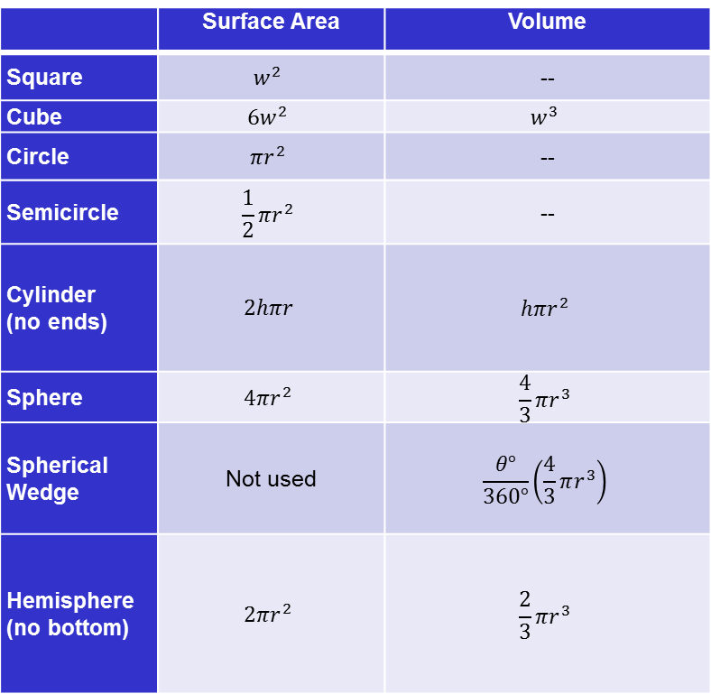
Basic Shape Formulas
 | Surface Area | Volume
Square |  | --
Cube
Circle |  | --
Semicircle |  | --
Cylinder (no ends)
Sphere
Spherical Wedge | Not used
Hemisphere (no bottom)

Slide 5
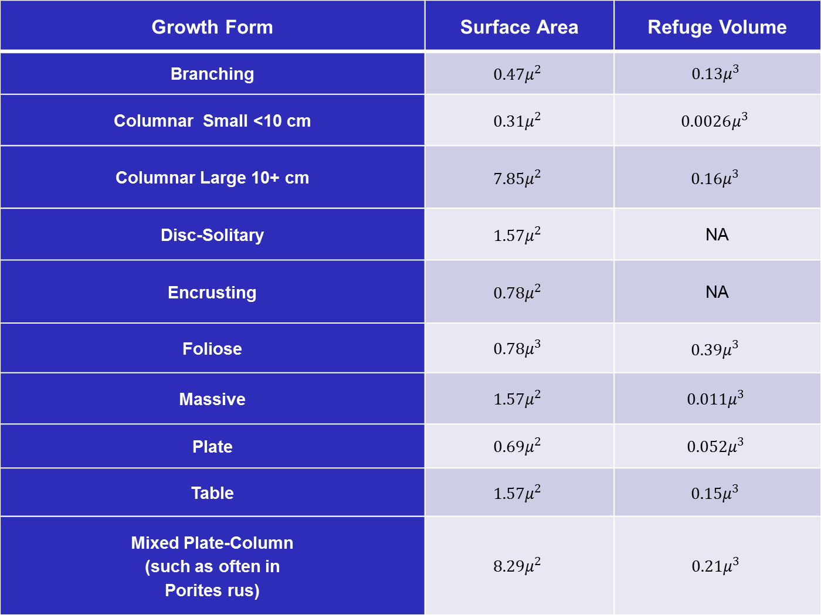
Growth Form | Surface Area | Refuge Volume
Branching | $0.47μ^{2}$ | $$0.13μ^{3}$$
Columnar Small <10 cm | $0.31μ^{2}$ | $0.0026μ^{3}$
Columnar Large 10+ cm | $7.85μ^{2}$ | $0.16μ^{3}$
Disc-Solitary | $1.57μ^{2}$ | NA
Encrusting | $0.78μ^{2}$ | NA
Foliose | $$0.78μ^{3}$$ | ${0.39μ}^{3}$
Massive | $$1.57μ^{2}$$ | $$0.011μ^{3}$$
Plate | $$0.69μ^{2}$$ | $$0.052μ^{3}$$
Table | $1.57μ^{2}$ | $0.15μ^{3}$
Mixed Plate-Column (such as often in Porites rus) | $$8.29μ^{2}$$ | $$0.21μ^{3}$$

Slide 6
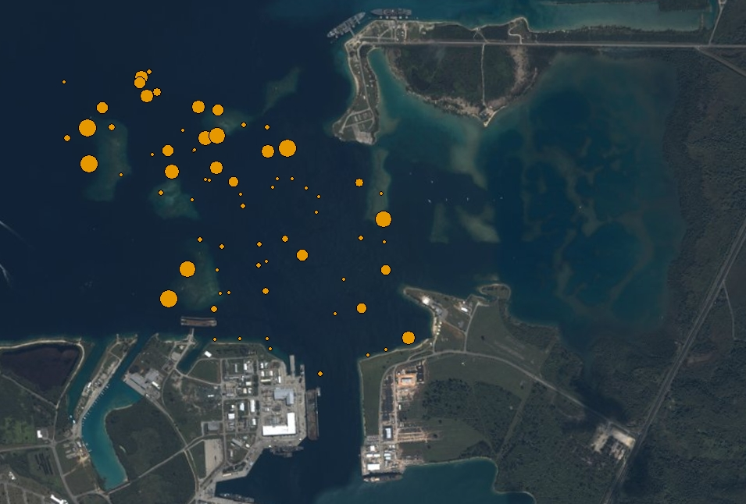
Application of Refuge Volume Estimation
Apra Harbor Guam will have dredging impacting up to 1 sq. km of reef area – the largest US reef mitigation case so far.
The map shows refuge volume available due to corals (larger circles mean more volume).
Evaluation of substrate and other HAB contribution to local refuge volume is underway.
This information is being used to minimize impacts and establish mitigation goals.

Slide 8
DigiReef for Habitat Equivalency Analysis
(HEA)

Slide 9
Problems with Assuming Linear Recovery
b
a

Slide 10
Simulation Parameters
Coral growth rate
  Used literature values
Coral rate of instantaneous mortality
  Applied catch curves to size data by species and form
  Where necessary, combined similar species
Coral rate of annual recruitment
  Used simple virtual population analysis
Colony maximal dimension
  Based on maximal sizes in the site

Slide 11
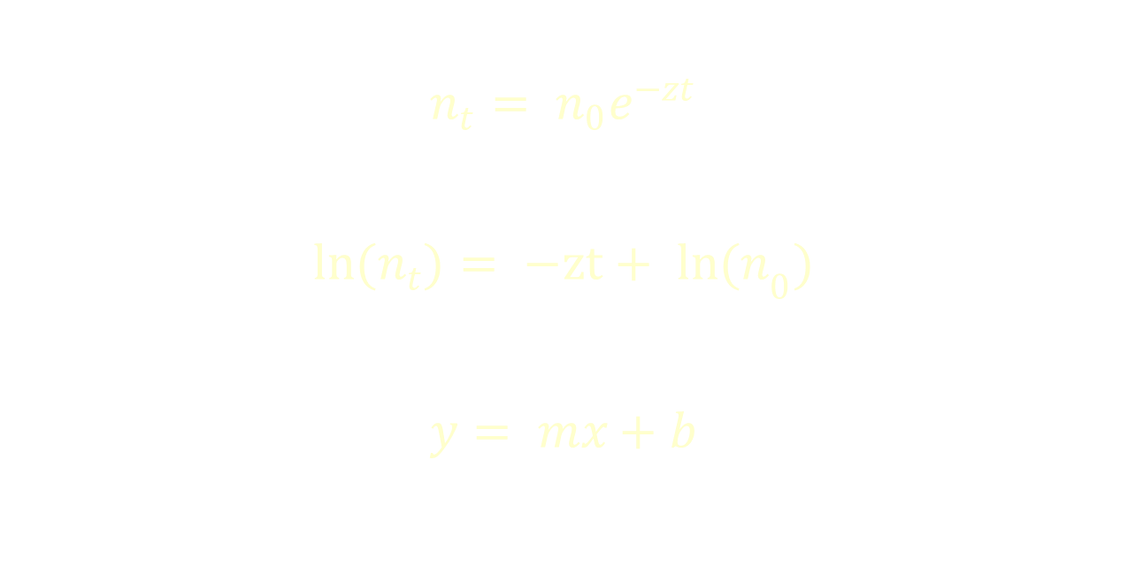
Estimating Rates of Mortality
$$n_{t}= n_{0}e^{−zt}$$
$$ln(n_{t})= {−zt+ ln(n}_{0})$$
$$y= mx+b$$

Slide 12
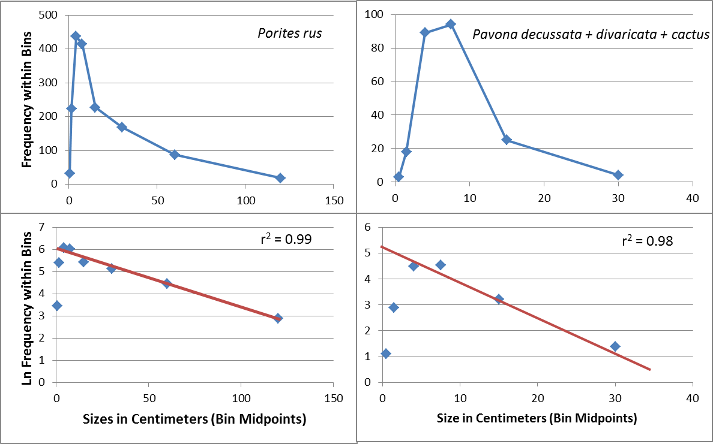
Estimating Rates of Mortality

Slide 13
Estimating Annual Recruitment
Age in Years or Radius in Centimeters
Year | 1 | 2 | 3 | 4 | 5 | 6 | 7 | 8 | 9 | 10
2001 | 100 | 61 | 37 | 22 | 14 | 8 | 5 | 3 | 2 | 1
2002 | 100 | 61 | 37 | 22 | 14 | 8 | 5 | 3 | 2 | 1
2003 | 100 | 61 | 37 | 22 | 14 | 8 | 5 | 3 | 2 | 1
2004 | 100 | 61 | 37 | 22 | 14 | 8 | 5 | 3 | 2 | 1
2005 | 100 | 61 | 37 | 22 | 14 | 8 | 5 | 3 | 2 | 1
2006 | 100 | 61 | 37 | 22 | 14 | 8 | 5 | 3 | 2 | 1
2007 | 100 | 61 | 37 | 22 | 14 | 8 | 5 | 3 | 2 | 1
2008 | 100 | 61 | 37 | 22 | 14 | 8 | 5 | 3 | 2 | 1
2009 | 100 | 61 | 37 | 22 | 14 | 8 | 5 | 3 | 2 | 1
2010 | 100 | 61 | 37 | 22 | 14 | 8 | 5 | 3 | 2 | 1
Empirical: | 1000 | 610 | 370 | 220 | 140 | 80 | 50 | 30 | 20 | 10

Slide 14
DigiReef Inputs: Site 93
 | Recruitment (settled corals per year)
 |  | Battle skill (relative hierarchy)
 |  |  | Growth rate (cm / y)
 |  |  |  | Instantaneous mortality
 |  |  |  |  | Volume factor
 |  |  |  |  |  | Maximum radius
Pavona decussata | 3 | 1 | 4 | 0.127 | 0.393 | 20
Pocillopora damicornis | 2 | 2 | 3 | 0.12 | 0.126 | 20
Porites cylindrica | 2 | 3 | 3 | 0.025 | 0.126 | 10
Porites lutea | 1 | 4 | 2 | 0.122 | 0.011 | 20
Porites rus | 1 | 3 | 2 | 0.027 | 0.21 | 30

Slide 15
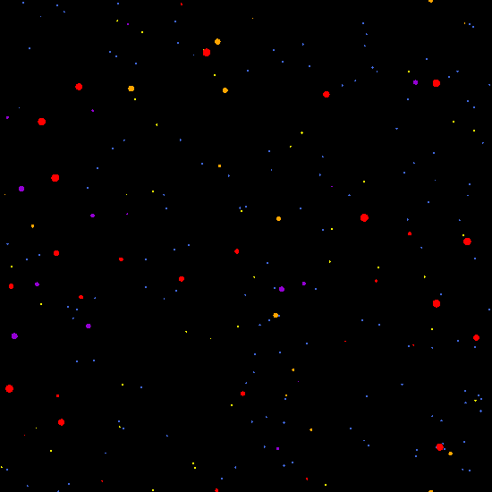
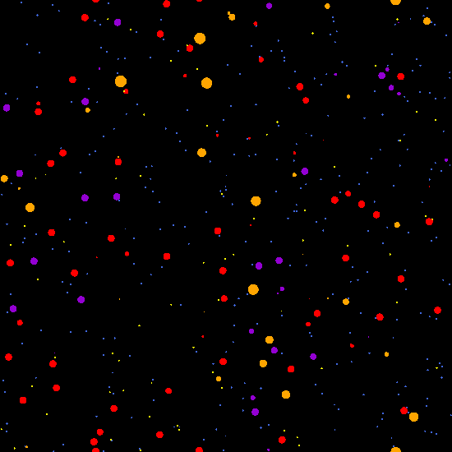
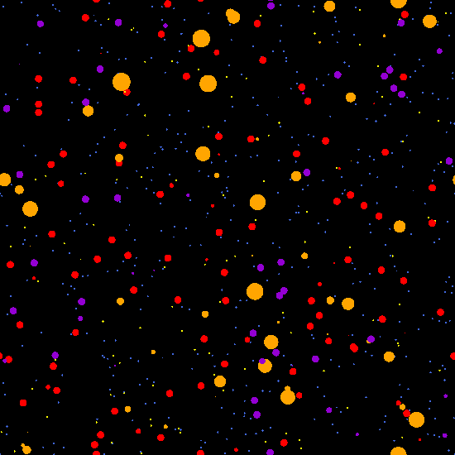
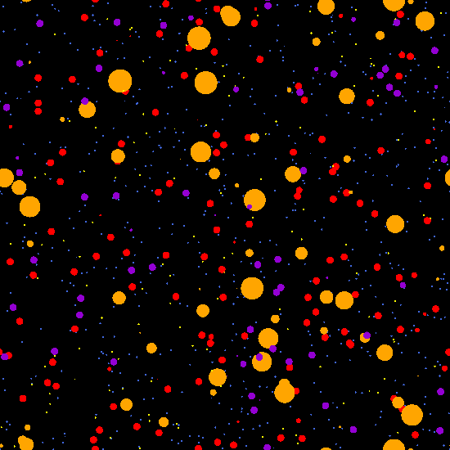
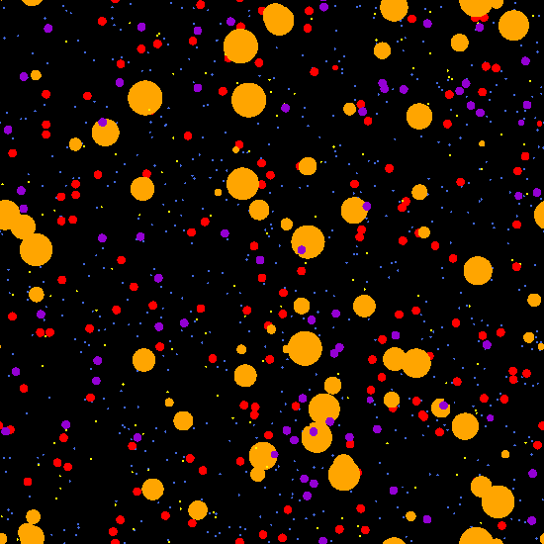
Color | Species
Blue | Pavona decussata
Red | Pocillopora damicornis
Yellow | Porites cylindrica
Violet | Porites lutea
Orange | Porites rus

Slide 16
Simulated Regrowth: Site 93
Total coral cover
Percent Coral Cover
Spectra of refuge volumes
Manhattan Metric Distance
Individuals per species
Manhattan Metric Distance
Spectra of sizes of massive corals
( Porites lutea )
Years of simulated regrowth

Slide 17
Conclusions I
Refuge volume is an important metric for quantifying ecosystem function.
It can be associated with corals, other habitat structuring benthos, and the substrate itself.
It is not necessarily well correlated with coral cover or surface area indices.
Estimation procedures still require improvements from field and laboratory measurements.

Slide 18
Conclusions II
DigiReef simulation can improve the basis for the determination of compensatory requirements in mitigation cases.
Coral mortality and recruitment can be roughly approximated via fishery analytical methods.
For one particular site, the original coral cover and size spectra of massive corals was optimally achieved, and community structure was nearly optimally achieved, within 40 years.
The spectrum of available refuge volumes was replicated within 8 years, because most was due to small branching and foliose coral colonies. These results will vary in different coral communities.

Slide 19
Acknowledgements
Our thanks to:
  Deborah Shafer and others at the US Army Corps of Engineers, Engineer Research and Development Center.
  US Navy, NOAA, US EPA, Gov. Guam, others, especially Steve Kolinski
  HDR-EOC and CSA International Consultancy Firms
  Dr. Yimnang Golbuu and others for field work

Slide 20
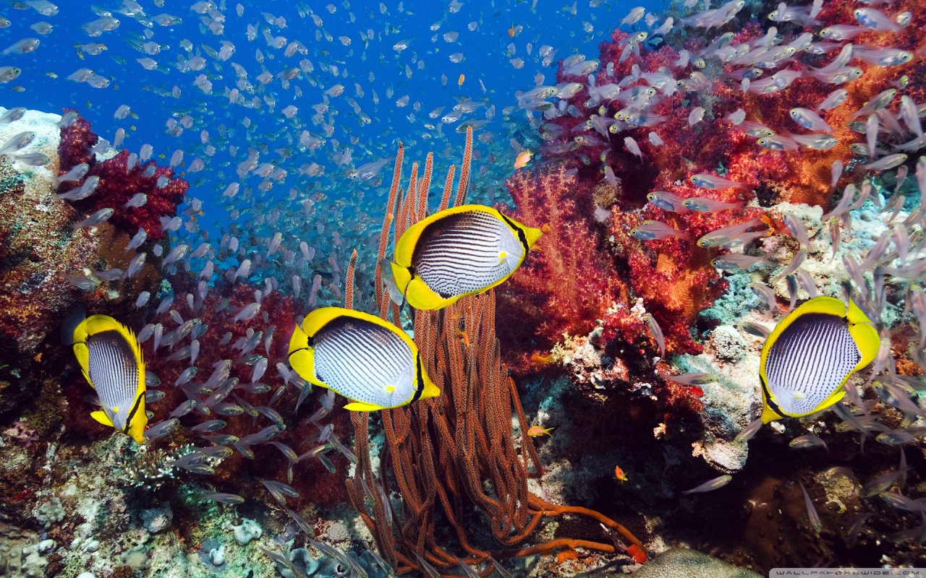
Thank you.

